Slide 1
THE CARBON CYCLE
Table : Estimated major stores of carbon on the Earth.
Sink | Amount in Billions of Metric Tons
Atmosphere | 578 (as of 1700) - 766 (as of 1999)
Soil Organic Matter | 1500 to 1600
Ocean | 38,000 to 40,000
Marine Sediments and Sedimentary Rocks | 66,000,000 to 100,000,000
Terrestrial Plants | 540 to 610
Fossil Fuel Deposits | 4000
Carbon dioxide enters the waters of the ocean by simple diffusion. Once dissolved in seawater, the carbon dioxide can remain as is or can be converted into carbonate (CO₃⁻²) or bicarbonate (HCO₃⁻). Certain forms of sea life biologically fix bicarbonate with calcium (Ca⁺²) to produce calcium carbonate (CaCO₃). This substance is used to produce shells and other body parts by organisms such as coral, clams, oysters, some protozoa, and some algae. When these organisms die, their shells and body parts sink to the ocean floor where they accumulate as carbonate-rich deposits. After long periods of time, these deposits are physically and chemically altered into sedimentary rocks. Ocean deposits are by far the biggest sink of carbon on the planet.

Slide 2
The Carbon Cycle
CO2 is added to the atmosphere by:
Respiration: C6H12O6 + 6O2 6CO2 + 6H2O
Burning fossil fuels: CH4 + 2O2 CO2 + 2H2O
Roasting limestone: CaCO3 CaO + CO2

Slide 3
The Carbon Cycle
CO2 is removed from the atmosphere by:
Photosynthesis: 6CO2 + 6H2O C6H12O6 +6O2
Dissolving in water (oceans, rivers, lakes, rain etc)
CO2 + H2O H2CO3

Slide 4
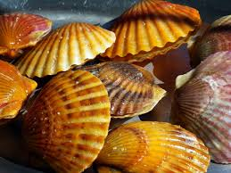
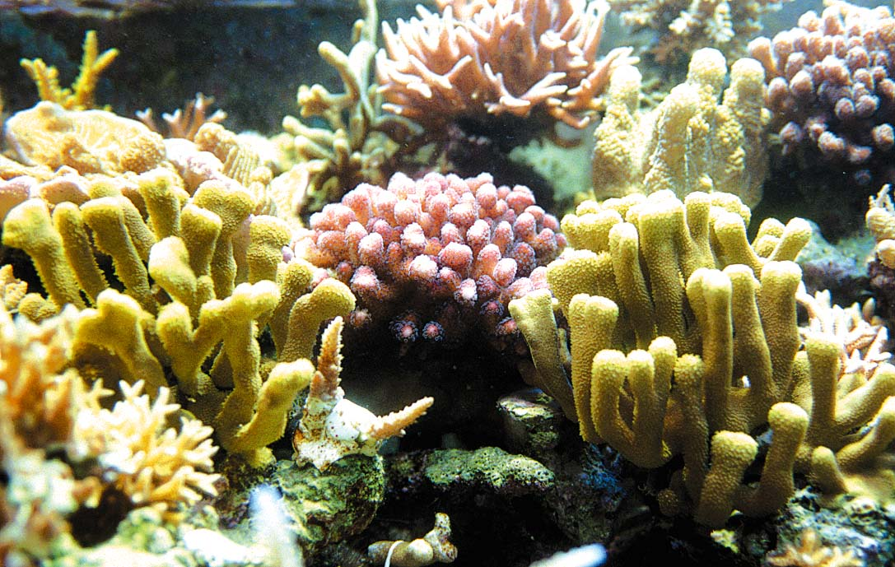
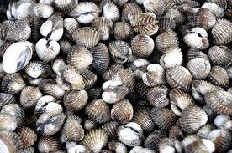
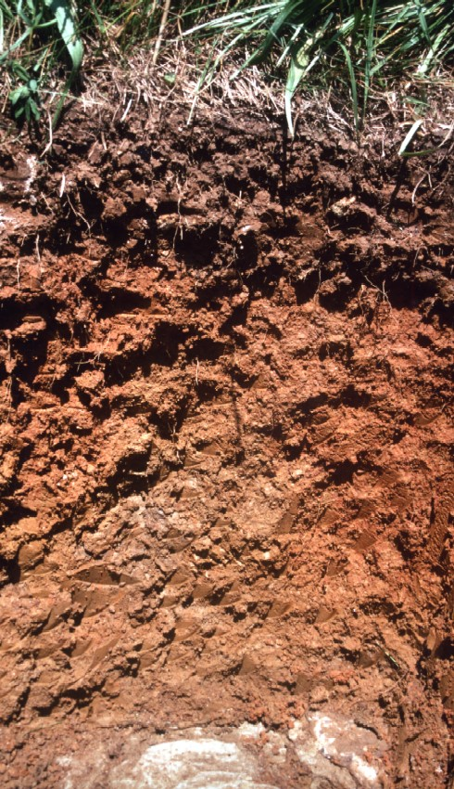
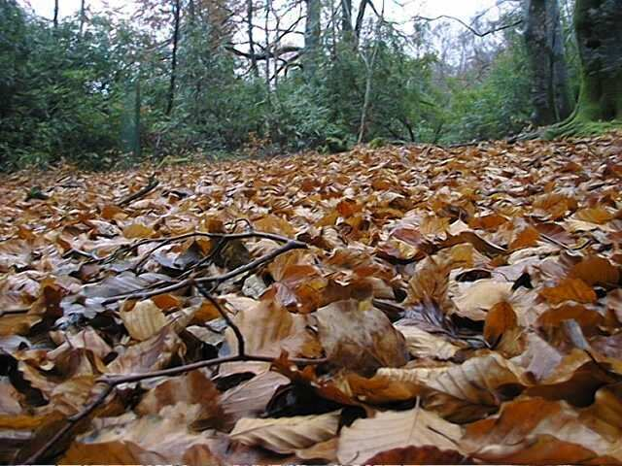
Carbon in Oceans
The oceans are by far the largest carbon sink in the world; Some 93 percent of carbon dioxide is stored in algae, vegetation, and coral under the sea.
Some sea life use bicarbonate to produce shells and body parts (coral, oysters, clams, some algae)
Organic: litter, humic substances found in soil
Humus is formed during the decomposition of plant and animal remains by microorganisms under aerobic and anaerobic conditions, usually in soils, water basins.

Slide 5
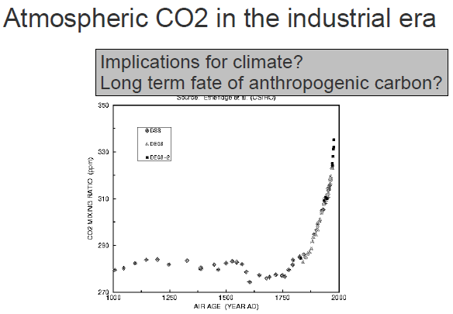
Human alteration of the carbon cycle
Since the Industrial Revolution, humans have greatly increased the quantity of carbon dioxide found in the Earth's atmosphere and oceans. Nowadays, of course, enormous quantities of carbon are put into the atmosphere by burning of fossil fuels. Atmospheric levels have increased by over 30%, from about 275 parts per million (ppm) in the early 1700s to just over 365 PPM today.
Scientists estimate that future atmospheric levels of carbon dioxide could reach an amount between 450 to 600 PPM by the year 2100. but that increase is in part offset by dissolution into the oceans and in part by increase in total plant biomass.

Slide 6
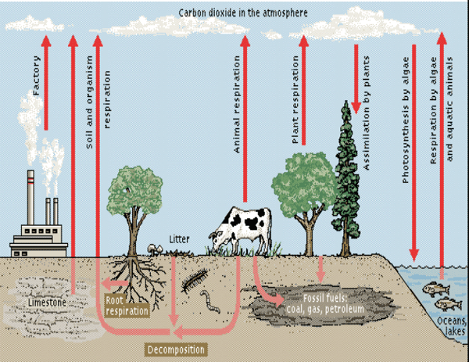

Slide 7
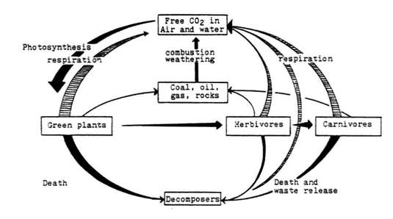

Slide 8
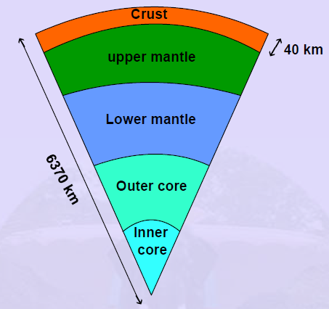
THE OXYGEN CYCLE
About Oxygen:
Just like carbon and hydrogen, oxygen is also an essential part of life.
Oxygen makes around 65% of the total mass of the body.
It makes around 30% of the earth and 21% of the atmosphere. Oxygen is found both inside the earth’s crust and also in atmosphere as carbon dioxide.
❖ It is found as carbonates, sulphates and nitrates.
❖ It is an important component of the biological molecules like proteins, nucleic acids etc.
Fig : Layers of earth

Slide 9
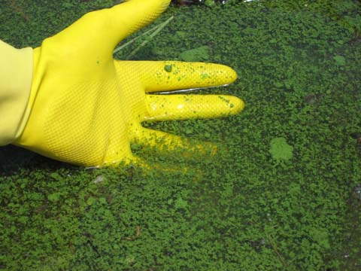
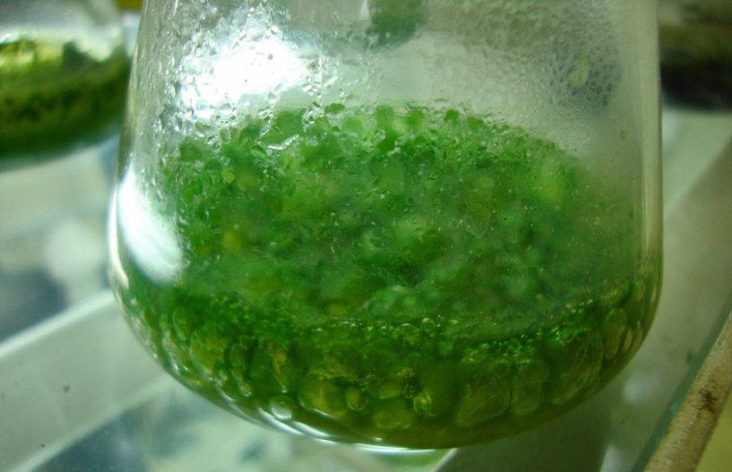
Phytoplankton is one of the biggest sources of oxygen that live near the ocean. They perform half of the world's photosynthetic activity. It is a micro-algae single-celled organism that is rich in trace minerals, chlorophyll, essential amino acids, DHA, EPA, carotenoids, antioxidants, nucleic acids and necessary vitamins. They are quite small and usually unicellular, though they often grow in colonies large enough to see. As the name suggests, it is originally derived from the ocean, where it is responsible for creating almost 70% of the earth’s oxygen supply. Among the common kinds are cyanobacteria, silica-encased diatoms, dinoflagellates, green algae, and chalk-coated coccolithophores., They are sensitive to climate change.
Marine phytoplankton is just microscopic algae that live on the ocean.
The blue-green algae (Because they are photosynthetic and aquatic, cyanobacteria are often called "blue-green algae". )

Slide 10
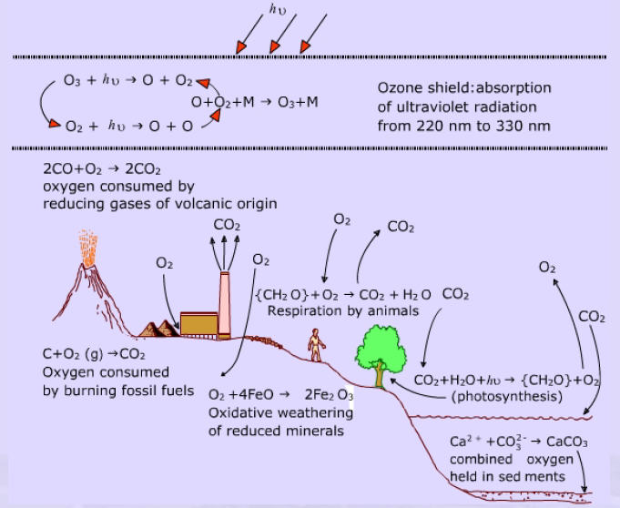

Slide 11
The importance of oxygen in atmospheric chemistry, geo chemical transformation and life processes is as follows :
• Atmospheric oxygen participate in energy producing reactions such as burning of fossil fuels,
• Atmospheric oxygen is utilized by aerobic organism in the degradation of organic material
• Oxygen is consumed by some oxidative weathering processes of minerals
• Photosynthesis by plants return the oxygen to the atmosphere.
• A form of oxygen containing species O₃ occurring in the stratosphere absorbs harmful UV radiation and serves as radiation shield.
• All the molecular oxygen now in atmosphere is thought to have originated through the action of photosynthetic organisms, which shows the importance of photosynthesis in the oxygen balance of atmosphere.

